Slide 1
Panel: Leveraging National Research Resources
Tue Sep 29 2015, Research Support Track, 1:15pm

Slide 2
Introductions
Moderator: Henry Neeman, University of Oklahoma, on behalf of XSEDE
Sam Scozzafava, Syracuse University, on behalf of the Open Science Grid
Barr von Oehsen, Clemson University, on behalf of the ACI-REF project
Jason Zurawski, ESnet Science Engagement

Slide 3
Henry Neeman, University of Oklahoma, on behalf of XSEDE

Slide 4
About Me
Job titles
  Asst VP IT - Research Strategy Advisor
  Director, OU Supercomputing Center for Education & Research (OSCER)
  Assoc Prof, College of Engineering
  Adjunct Assoc Prof, School of Computer Science
Other roles (examples)
  Co-lead, OneOklahoma Cyberinfrastructure Initiative
  Member, NSF Advisory Committee on CI
  Member, Internet2 High Performance & Research Computing Program Advisory Group
  Non-resident Fellow, Samuel Roberts Noble Foundation
  Coming summer 2016: Co-manager, XSEDE Campus Engagement

Slide 5
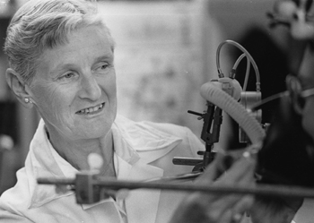
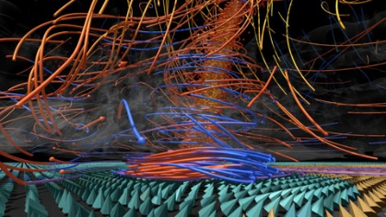
Why Do We Do This?
My whole career, starting from sophomore year in college, has been built around helping STEM researchers use computing in research and education.
Computational Science & Engineering makes the impossible possible; High Performance Computing makes the impossible practical.
The machines are groovy, and we surely do love them, but they’re a means, not an end.
http://library.buffalo.edu/archives/womens_work/bios/bishop.htm
My first research boss, Prof. Beverly Bishop, University at Buffalo Physiology (died 2008).
http://avl.ncsa.illinois.edu/astrophysics/interactive-tornado-kiosk-at-msi-science-storms

Slide 6
What is XSEDE?
XSEDE is an umbrella over, a collaboration among, and a resource for, several NSF-funded CI service providers.
  Lots of exciting new resources coming online this year!
XSEDE provides national leadership in CI for fundamental research across all STEM disciplines; e.g.,
  THINGS: National-scale resources and facilities.
  PEOPLE: Campus Engagement, Education & Training, Extended Collaborative Support Service (ECSS), etc.
XSEDE is home to some of the world’s top CI experts.

Slide 7
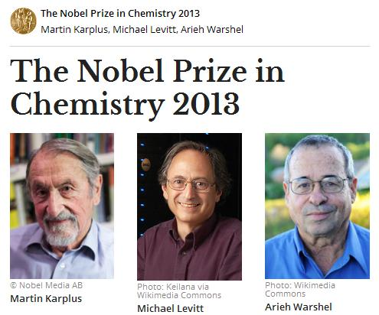
How to Leverage XSEDE?
For your own research:
  Get an account and an allocation on XSEDE resources.
    Or work with your local Campus Champion to get those.
  Attend XSEDE training.
  Get help with your community’s software from ECSS.
  Run lots of jobs, produce great research outcomes, win a Nobel Prize!
For your institution:
  Become a Campus Champion.
  Become a Service Provider (Level 3 is very gentle).
http://nci.org.au/2013/10/10/computational-chemistry-wins-the-nobel/

Slide 8
Sam Scozzafava, Syracuse University, on behalf of the Open Science Grid

Slide 9
Syracuse University - Overview
Located in Syracuse, NY (central upstate New York)
14,000+ undergraduate students
5,000+ graduate students
Faculty: 1,100+ full-time, 90+ part-time, 450+ adjunct
Research: $67+ million awarded for research, teaching and other sponsored programs in 2014

Slide 10
Syracuse University – Research Computing Resources
OrangeGrid: HTC environment developed in 2012 that currently makes ~12,000 cores available from idle desktop computers.
Crush: medium scale virtualized research cloud; designed for compute intensive work; think “cluster within a cluster”. 8,000+ cores, 40+ TB of memory
Academic Virtual Hosting Environment (AVHE): private compute cloud; small to medium sized research efforts. 600+ cores, 7 TB of memory, ~1 PB of storage
More at http://researchcomputing.syr.edu/

Slide 11
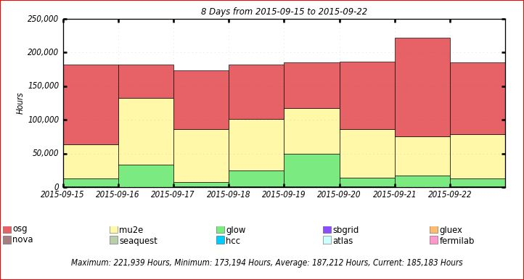
Syracuse University – Open Science Grid (OSG)
SU has contributed resources to OSG for ~1 year.
Contribution stats for a recent 7 day period:

Slide 12
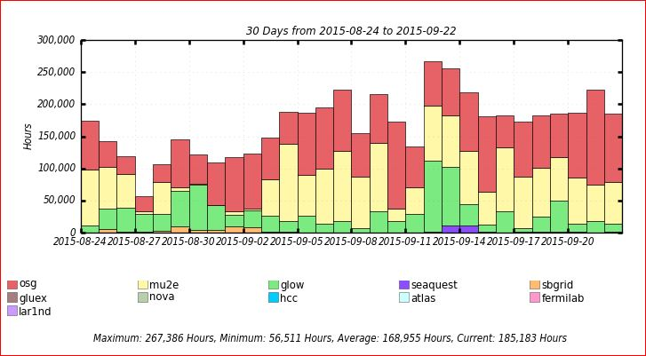
Syracuse University – Open Science Grid (OSG)
Contribution stats for a recent 30 day period:

Slide 13
Campus Bridging Through Facilitation: The ACI-REF Project
Campus Bridging: Reducing Obstacles on the Path to Big Answers
Barr von Oehsen
Clemson University

Slide 14
Ever Changing ACI Ecosystem
National – HPC as Demand Driver
  Labs, Centers, PACI, TeraGrid, XSEDE (Levels 1, 2, and 3, Comet, Jetstream, Bridges, Wrangler), OSG, CloudLab, Chameleon
Regional – LSU, Stanford, UC Boulder, and MGHPCC
Campus Computing Demand Growing in Parallel
  MRIs, CRIs, Start-Up Packages
  Condo and Co-lo Approaches
  Big Data Driving New Communities
Cloud Services - AWS, Azure, etc.
Advanced Networking – AL2S, the Quilt, Science DMZs, SDN, CC*??
User applications changing, digitalization of data
Bottom line: User/Application support can’t keep up and Researchers need help in navigating the ecosystem

Slide 15
An Approach
Answered Need: The ACI-REF Project (People)
Goal: Seed investments in user-facing people – facilitators – at campuses to:
  Assist researchers in taking advantage of advanced computing resource investments, especially at the local campus level; and
  Build inter-institutional collaborative networks of knowledge to share expertise across campuses.

Slide 16
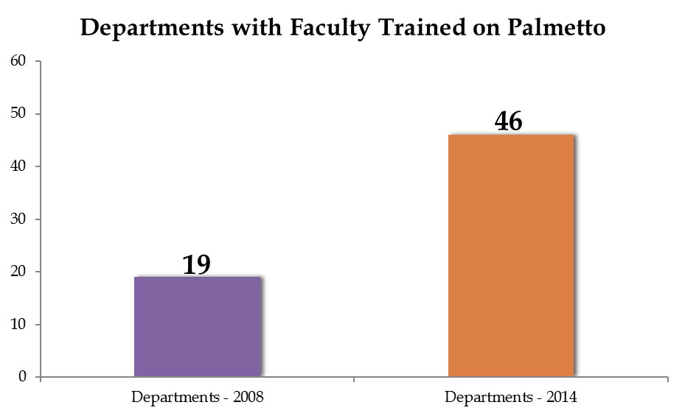

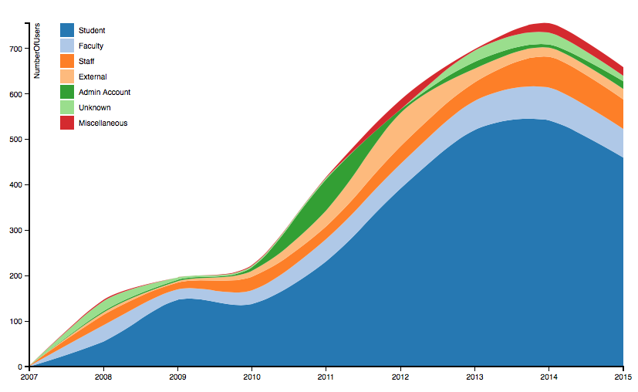
One Campus’ Experience
54 Clemson Academic Departments
Clemson
May 2010 – first Clemson “facilitator” funded
54
54
88%
35%
May 2010: NSF Outreach &
Infrastructure Improvement
Grant Funded

Slide 17

Non-Traditional Impacts
Departments Receiving Hadoop Training
Case Study: Hadoop In Action
Kevin McKenzie, Clemson Chief Information Security Officer, and his team used the Clemson Hadoop platform as part of a recent security incident response. His team needed to evaluate multi-year volumes of log data from the Clemson network to validate the extent of an incident they were investigating. The team loaded log data into the Hadoop cluster to gain a higher performance of log analysis.
Using Hadoop proved very beneficial, as it eliminated the estimated weeks (if not months) to accomplish on current local systems and the analysis was completed in less than a couple of hours, allowing the team to more quickly determine the extent of the issue.
Bioengineering
Chemical Engineering
Chemistry
Civil Engineering
Economics
Elec. & Computer Engr.
Environmental Engr & Earth Sci
Experiential Education
General Engineering
Genetics & Biochemistry
Industrial Engineering
International Programs
Law Enforcement & Safety
Management
Mathematical Sciences
Mechanical Engineering
Medicaid IT Services
Physics And Astronomy
Public Health Sciences
Research Safety
School of Ag. For. Env Science
School of Computing
Univ Facilities Support Svcs
VP Finance & Operations
Information Security & Privacy

Slide 18
ACI-REF Formation
Award for NSF-sponsored workshops held in 2012 helped define the needs of the broader community
Goal: Advance our nation's research & scholarly achievements through the transformation of campus computational capabilities and enhanced coupling to the national infrastructure.

Slide 19
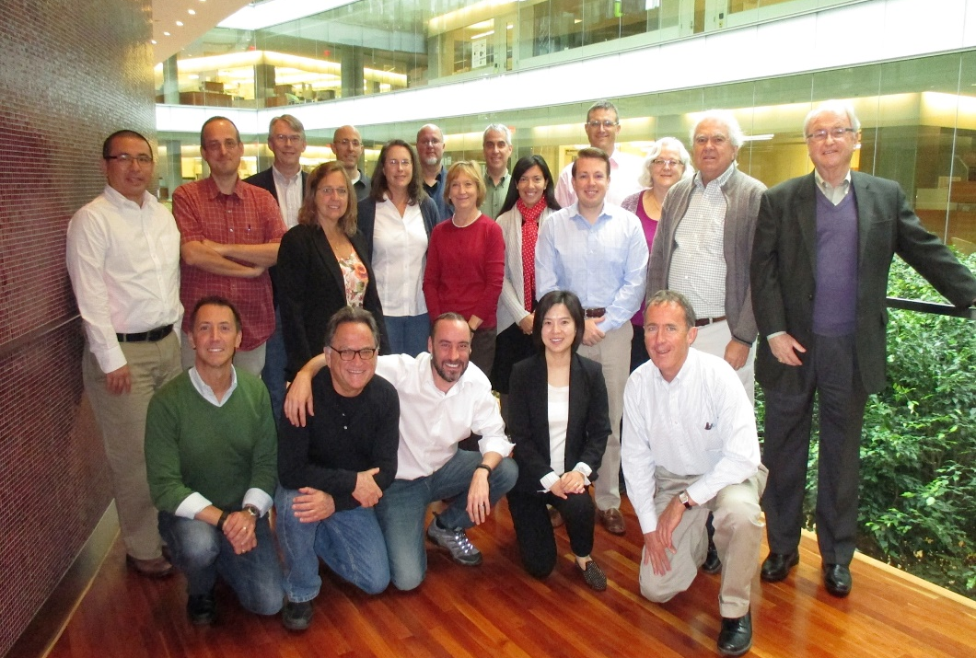
NSF-Funded Project – ACI-REF
$5.3M NSF Award supports the project leadership team and 2 Facilitators for each of the 6 partner sites for 2 years.
PI: Jim Bottum, Clemson
Project Leadership:
James Cuff, Harvard (PI Chair)
Maureen Dougherty, USC
Gwen Jacobs, Hawaii
Paul Wilson, Wisconsin
Tom Cheatham, Utah
Barr von Oehsen, Clemson
Facilitator Lead: Bob Freeman, Harvard
Chief Scientist: Miron Livny, Wisconsin

Slide 20

Jason Zurawski ESnet Science Engagement zurawski@es.net engage@es.net

Slide 21
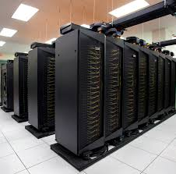
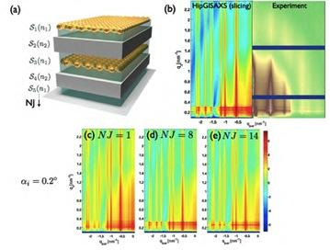

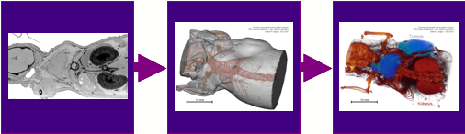
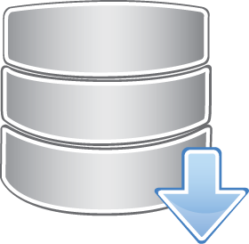
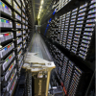
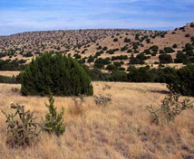

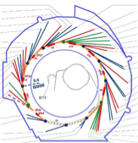
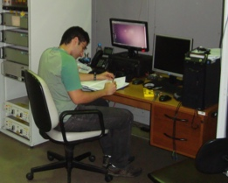





A Brief Tour of “Science”
predictable data movement
on-the-fly calibration
Analysis and modeling
Local Data
processing/filtering
Real-time access and Visualization
Storage, Archive and Share
Data generation from Sensors
On-site Scientist
Remote
users

Slide 22
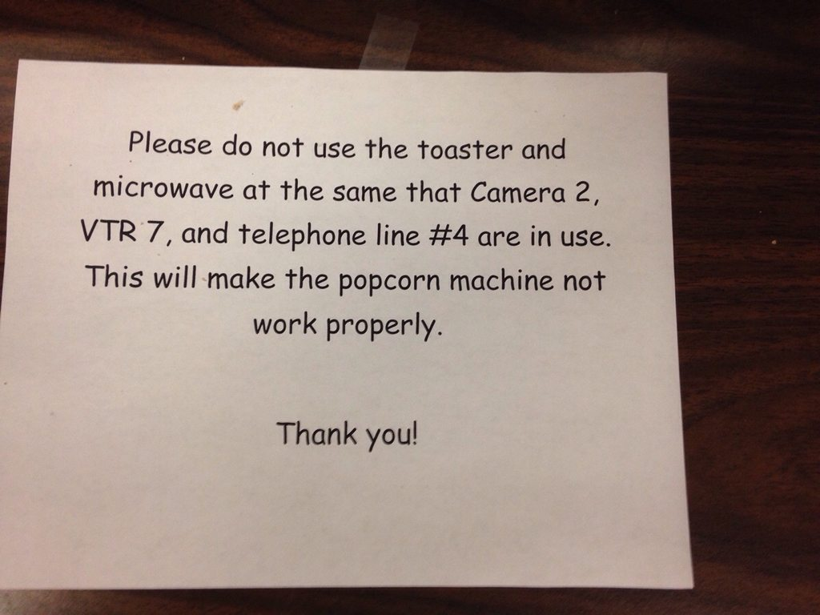
Removing the Mystery from Networking
Notes:
Impacted user communities have ‘figured it out’ for years. They have an app they like to use, special services, a way of doing things (the word ‘workflow’ may be a little of a stretch though)
We have found that sitting down and talking to people is the best way to figure out the points of friction. We call these requirements reviews, and they involve a lot of discussion about ‘what’ and ‘why’ – we can pretty much figure out the ‘how’.

Slide 23

Planning Ahead
Notes:
For the campus folks – there is a problem of choosing a solution before the problem is understood. This is a huge mistake. Picking the technology first, and then announcing to the user’s that they have to use it will lead to a lot of heartache.
I am looking at you SDN, or security appliance du-jour. Equally – don’t buy the cheapest switch, or the switch that won’t meet your needs (e.g. ‘data center’ !=WAN)

Slide 24
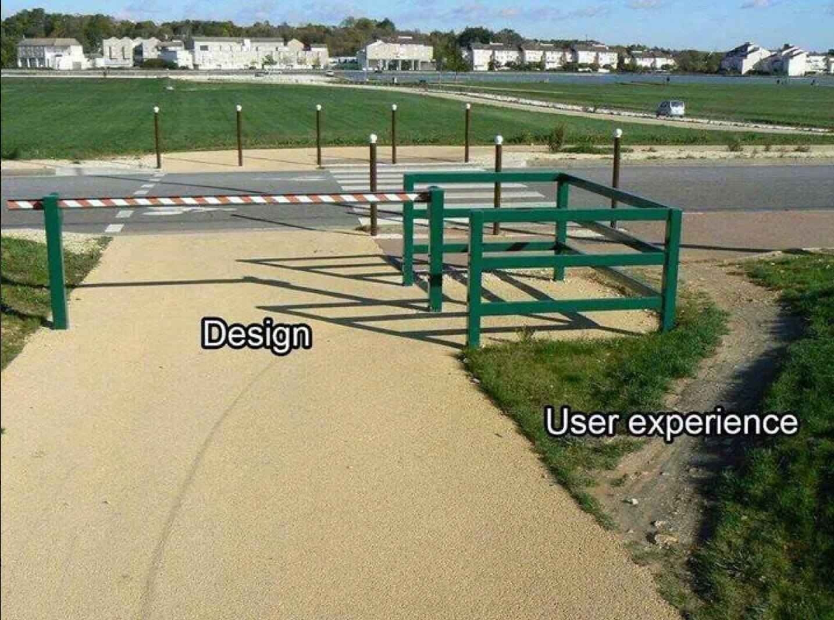
Measure Twice, Cut Once
Notes:
All technology changes come with a barrier to use/adoption, and may introduce new and unseen layers of friction.
We found that savings (cost, time, effort) that you may see by rushing the approach will lead to deficits later on.
I would stress that a critical requirement of any network upgrade is measuring before/after raw performance numbers, but also human performance numbers

Slide 25






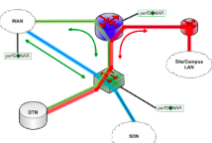


ESnet Approach to Engagement
Education & Consulting
Webinars, workshops, 1:1 data mobility consultations with scientists, support teams.
Partnerships
With facilities / research teams / providers, building foundation for lasting impact.
Resources & Knowledgebase
Reference designs, case studies, papers, FAQs – tailored for multiple audiences.

Slide 26
Panel Discussion Questions
What are the synergies between each of these respective CI facilitation programs?
What does scalability look like to reach the 100s of institutions and 1000s of users?
What are the largest risks that stand in the way of success? Are there ways to mitigate these?
Once the "easy" problems are solved, what is the next step?
How can adoption of these assistance programs be encouraged (more than the current approaches)?

Slide 27
Panel Discussion Questions (sample questions for ESnet)
What are the common problems that impact scientific users on networks?
How do we scale the job of engagement beyond the confines of one organization?
Notes:
Data movement is the ‘killer app’, and Packet loss (of various causes) is the arch nemesis. Security, wrong application, wrong host, wrong network gear, lack of capacity. Most importantly, we don’t want the scientific user to get frustrated and go back to sneakernet. We want the engineers to be prepared with solutions to common problems – and there are many OTS solutions for the above mentioned problems.
‘roll the snowball’ examples for a patient user – then crowing about the results. Adopting a requirements review way of doing things to figure out the needs. Writing down what you learned, and sharing it as much as possible – after you do the previous two.

Slide 28
Panel Discussion Questions (sample questions for SU and their participation with OSG)
Why does Syracuse University contribute to OSG?
Over time, how do you anticipate your contributions to OSG to change (increase, decrease, level-off)?

