Slide 1
Trustworthy Computational Science
Science meets cybersecurity
Von Welch
Director, CACR
Indiana University
2015 Campus Cyberinfrastructure PI Workshop
September 29th, 2015

Slide 2
Interdisciplinary, holistic, risk-based approach to cybersecurity.
Bridge cybersecurity research and practice.
Externally facing, with projects funded by NSF, DOE, DHS, …

Slide 3
TrustedCI.org
Advance the NSF community’s understanding and implementation of cybersecurity for science.
Three-year project funded by NSF ACI.

Slide 4
My talk: Cybersecurity and Science
The rise of scientific computing.
Cybersecurity as risk management.
What are the risks to science?
What can science teach cybersecurity?
Putting it all together.
How put this into practice?

Slide 5
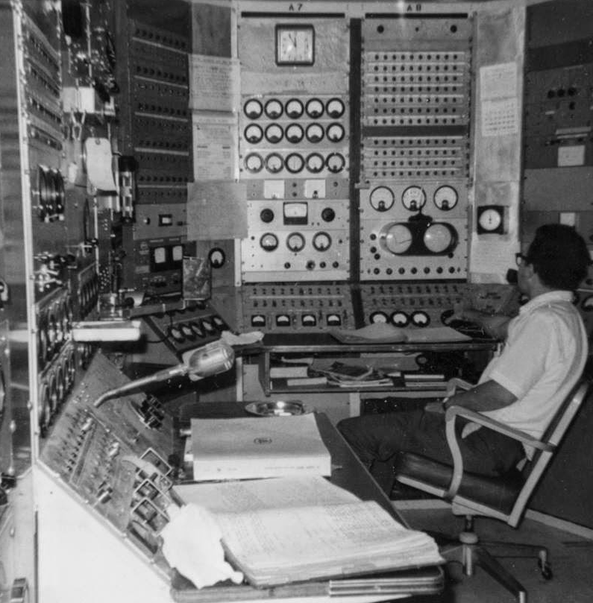
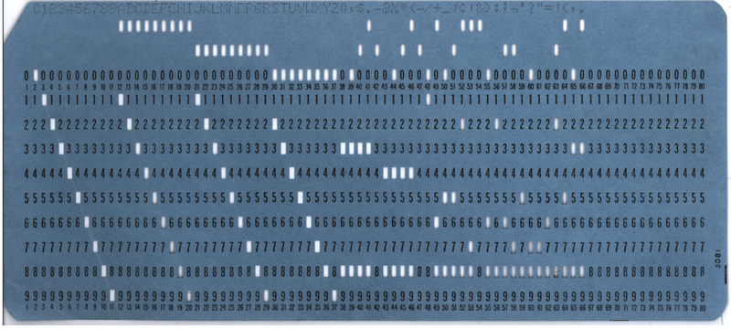
The “Good Old Days”
Scientists were employees or students, physically co-located.
Image credit: Lester Welch
Image credit: Wikipedia
Notes:
Bottom right photo is Lester Welch at controls of Linac, USC.

Slide 6
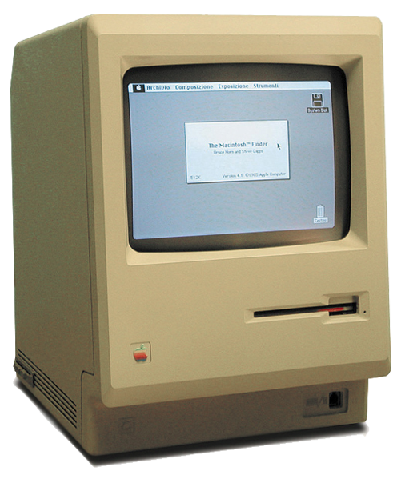
Then remote access…
Scientists start being remote from the computers.
But still affiliated with computing centers.
Image credit: All About Apple Museum Creative Commons Attribution-Share Alike 2.5 Italy

Slide 7
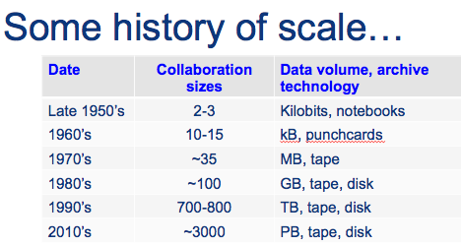
Growth of the scientific collaboration
Number of scientists, institutions, resources.
Large, expensive, rare/unique instruments.
Increasing amounts of data.
Image credit: Ian Bird/CERN

Slide 8
Cybersecurity Historically
Firewalls, IDS, encryption, logs, passwords, etc.
Not inspirational to the science community.

Slide 9
Contemporary Cybersecurity
Cybersecurity supports the organization’s mission by managing risks to science.

Slide 10
Maximizing Trustworthy Science
Trustworthy
Science
Output
No security:
Untrustworthy science,
Constantly hacked computers
Ideal
Risk
Management
Ultimate security:
Computer
in safe at bottom
of ocean
Notes:
NOTE: Science OUTPUT, not trustworthy nature of science.

Slide 11
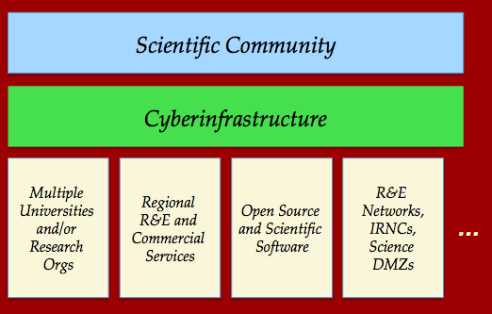
What are the risks to Science?
?
Notes:
NOTE: Clarify this is risks from top two levels.

Slide 12
Integrity of Results
Integrity of data and computation are critical to maintaining the trust of scientists and the public in CI.
Perception of integrity is often just as important as reality.

Slide 13
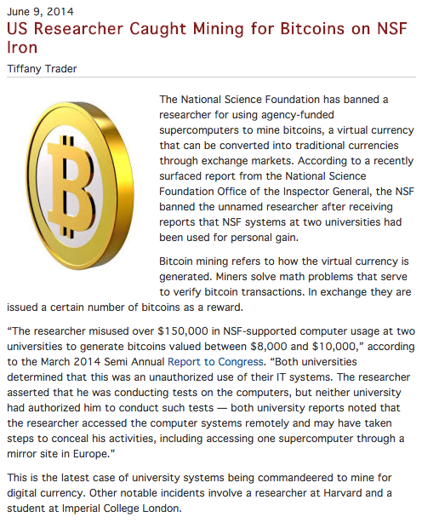
Do No Harm
Cyberinfrastructure represents some impressive cyber-facilities.
Being used as a tool to harm others would be very damaging to one’s reputation.

Slide 14
Collaboration is key to science. Trust is key to collaboration.

Slide 15
Managing the collaboration
Scott Koranda/LIGO - Oct’11

Slide 16
Specific Concerns
Many science domains, communities, and projects have particular concerns.
The risks related to confidentiality, integrity, and availability vary greatly, and go by their own nomenclature.

Slide 17
How do we manage these Risks?
Scientific Community
Cyberinfrastructure
Universities and/or Research Orgs
Regional R&E and Commercial Services,
InCommon R&S
Open Source and Scientific Software
R&E Networks,
IRNCs,
Science DMZs
…

Slide 18
Risk Management
Prevention: Firewalls, authentication, authorization, awareness, training, etc.
Detection: Bro, IDS, honeypots, darknet, etc.
Response: Dynamic blocking, auditing, exercise, etc.
Mitigate/transfer: Isolation, insure, encrypt, etc.
Accept.

Slide 19
Leverage services and cybersecurity
Research computing, storage, networking, software, etc.
And security effort going into those services.
Conserve effort for science-specific challenges.
Universities and/or Research Orgs
Regional R&E and Commercial Services,
InCommon R&S
Open Source and Scientific Software
R&E Networks,
IRNCs,
Science DMZs
…

Slide 20
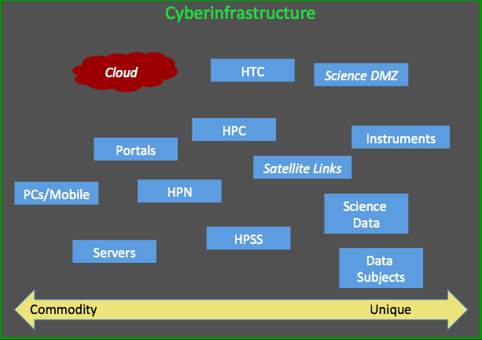
Commodity IT
Use baseline cybersecurity practices from NIST and others.
E.g. http://trustedci.org/guide/docs/commodityIT
Commodity IT

Slide 21
Unique IT/Instruments/Data/etc.
Must understand and manage risk
A custom task – can be helped with resources
E.g. http://trustedci.org/guide/
Unique Assets

Slide 22
What about the Science itself?
Scientific Community
The mission we are ultimately supporting.
But is that all?

Slide 23
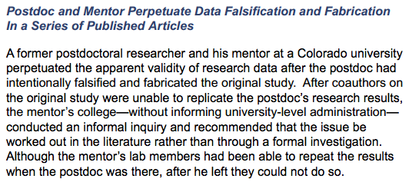
Science Risks
Biases
Errors
Fabrications
http://www.nsf.gov/oig/reports/

Slide 24
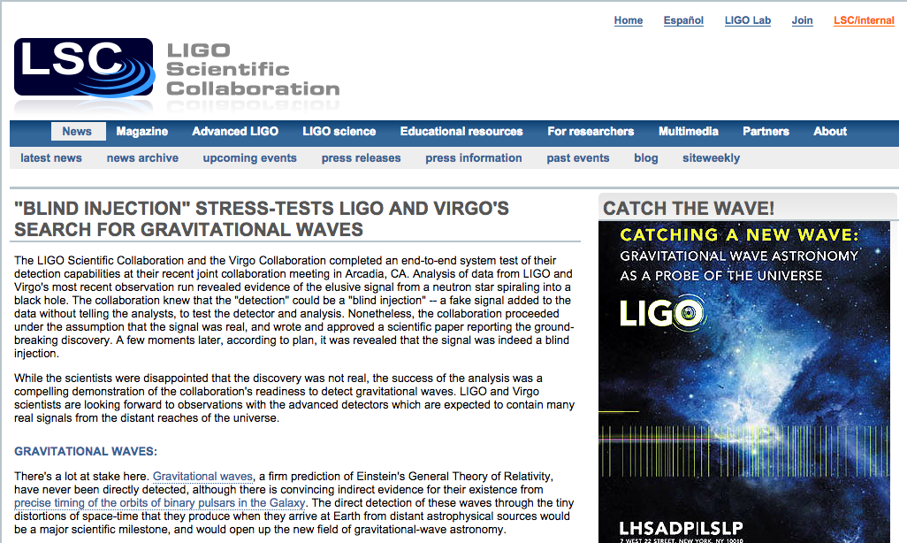
Science Manages Risks as Well
http://www.ligo.org/news/blind-injection.php

Slide 25
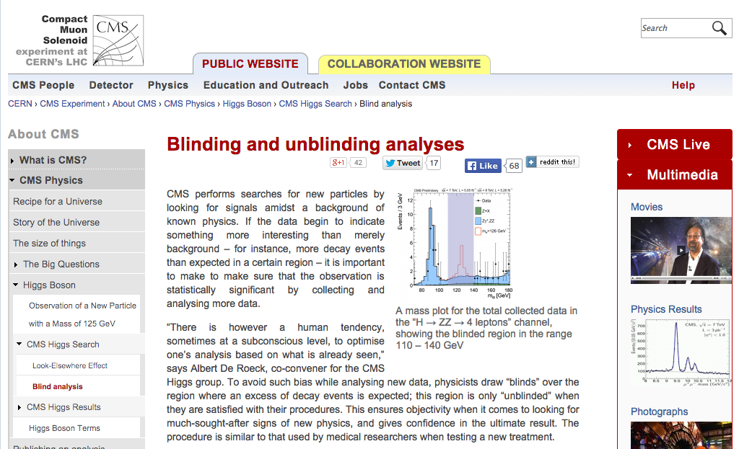
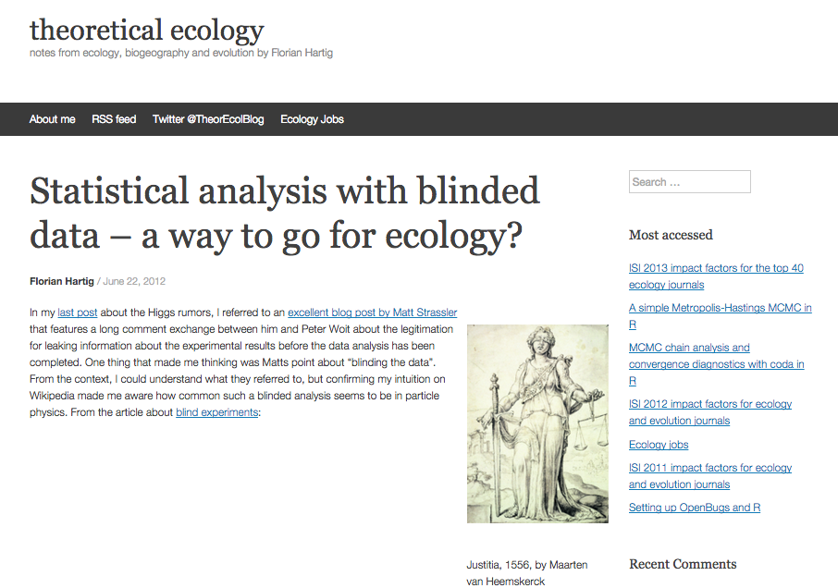
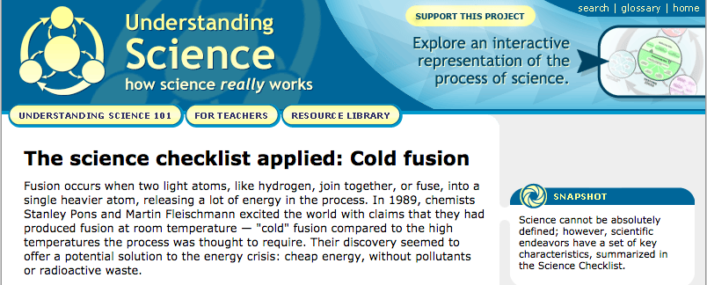
http://cms.web.cern.ch/news/blinding-and-unblinding-analyses
http://undsci.berkeley.edu/article/cold_fusion
https://theoreticalecology.wordpress.com/2012/06/22/statistical-analysis-with-blinded-data-a-way-to-go-for-ecology/

Slide 26
Maximizing Trustworthy Science: The Ideal
Trustworthy
Science
Output
Cybersecurity Risk Management
Science Risk Management
+
Notes:
NOTE: Science OUTPUT, not trustworthy nature of science.

Slide 27
Putting it all together…
Leverage science processes, understand mission and risks.
Scientific Community
Cyberinfrastructure
Baseline controls, risk management.
Multiple Universities and/or Research Orgs
Regional R&E and Commercial Services,
InCommon R&S
Open Source and Scientific Software
R&E Networks,
IRNCs,
Science DMZs
Leverage services and cybersecurity to conserve effort.
…

Slide 28
How do we put this into practice?
Notes:
OK, so what are we doing about the weather?

Slide 29
DOE Advanced Scientific Computing Advisory Committee Workforce Subcommittee Letter
“In particular, the findings reveal that: All large DOE national laboratories face workforce recruitment and retention challenges in the fields within Computing Sciences that are relevant to their mission (…), including Algorithms (both numerical and non-numerical); Applied Mathematics; Data Analysis, Management and Visualization; Cybersecurity; Software Engineering and High Performance Software Environments; and High Performance Computer Systems.“
http://science.energy.gov/~/media/ascr/ascac/pdf/charges/ASCAC_Workforce_Letter_Report.pdf
Notes:
NOTE: Something about workforce in general
Advanced Scientific Computing Advisory Committee (ASCAC)

Slide 30
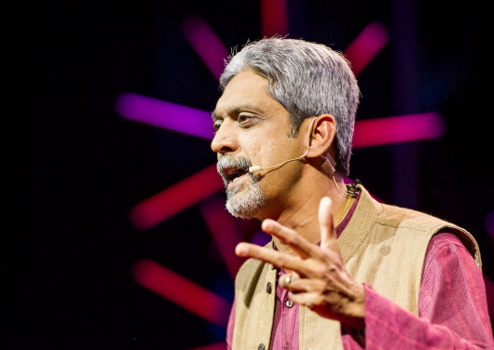
Maximizing Limited Expertise
http://blog.ted.com/bridging-the-gulf-in-mental-health-care-vikram-patel-at-tedglobal2012/
Notes:
Vikram Patel: India should have 150,000 psychiatrists to have the same proportion as the UK, but the number is actually about 3000.
Zimbabwe - about a dozen psychiatrists in the whole country.

Slide 31
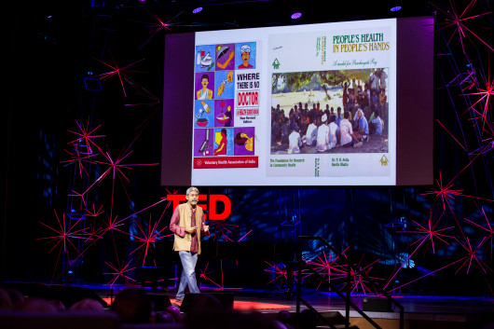
SUNDAR
Simplify the message
UNpack the treatment
Deliver it where people are
Affordable and available human resources
Reallocation of specialists to train and supervise
Notes:
Sundar == Beautiful in Hindi

Slide 32
CTSC version of SUNDAR
Engagements
LIGO, SciGAP, IceCube, Pegasus, CC-NIE peer reviews, DKIST, LTERNO, DataONE, SEAD, CyberGIS, HUBzero, Globus, LSST, OOI, NEON, Gemini, AoT.
Education and Training
Guide to Developing Cybersecurity Programs for NSF Science and Engineering Projects, Securing Commodity IT in Scientific CI Projects, Baseline Controls and Best Practices, Training for CI professionals.
Leadership
Organized 2013, 2014 & 2015 Cybersecurity Summits for Large Facilities and CI, vulnerability awareness, Cybersecurity for Large Facilities Manual.
Notes:
Simplify the message, UNpack the treatment, Deliver it where people are, Affordable and available human resources, Reallocation of specialists to train and supervise

Slide 33
Cybersecurity Program Guide
Baseline practices and risk management, tailored for science projects with guidance and templates.
http://trustedci.org/guide/

Slide 34
In conclusion…
Cybersecurity for science is about managing risks for science to maximize trustworthy science.
Science itself has much to offer in the process if we can figure out how the worlds of cybersecurity and science interact.
By leveraging our specialists for training and maximum impact, we can overcome workforce constraints to make this a reality.
More information: vwelch@iu.edu / trustedci.org

Slide 35
Acknowledgements
Colleagues at CACR, CTSC, XSIM.
Mike Corn, Adam Lyon, Marlon Pierce, Anurag Shankar, Scott Teige for discussions and feedback.
National Science Foundation (Grant 1234408).
Department of Energy Next-Generation Networks for Science (NGNS) program (Grant No. DE-FG02-12ER26111).
Uncredited images: http://www.thinkstockphotos.com/
Plug: Join InCommon, release attributes to R&S
The views and conclusions contained herein are those of the author and should not be interpreted as necessarily representing the official policies or endorsements, either expressed or implied, of the sponsors or any organization

