Slide 1
Opening the Black Box
Using Web10G to Uncover the Hidden Side of TCP CC PI Meeting Austin, TX
September 29, 2015
rapier@psc.edu

Slide 2
The Black Box of TCP
Packets go in and packets go out
But what happens in the stack?
Few mechanisms to observe in real time
Throughput little better than “Check Engine” light
Observations are difficult
Analysis after the fact not as useful as advertised
Real time observation often incurs significant cost and complexity
Would knowing more help?
Yes, depending…

Slide 3
Opening the Box
Web10G
Set of 127 instruments conforming to RFC 4898
Built as patch to Linux kernel
Includes kernel module and API
TCP_INFO
Part of the TCP stack (Linux 2.4)
Contains 38 instruments (Linux 4.2)
Available as a tcp option via getsockopt

Slide 4
Web10G
Advantages
Collects more data of interest (application performance, path characteristics, &c)
Kernel is aware of MIB and can tell userland what instruments are supported.
Uses independent memory space in kernel
Metrics persist after socket close
API makes working with metrics easy
Also correlates data to calling application
Disadvantages
Not in mainline – yet
Slightly higher memory requirements

Slide 5
TCP_INFO
Advantages
Well supported in kernel
No additional overhead
Disadvantages
Not well documented
Smaller instrument set
Struct is hardcoded
May not be portable between Linux kernels
Increases socket memory footprint
Though this is unavoidable.

Slide 6
It’s Not About Collecting Data
Gathering data is pointless if we don’t use it.

Slide 7
Some questions:
What if we could see what is happening in a flow in real/near real time?
What if we could apply advanced heuristics to identify marginal and failing flows?
What if we could use this specifically for large data flows from, to, and between Science DMZs?
What if we could use this to monitor inter-domain traffic across an R&E?

Slide 8
Answer

Slide 9
A Better Answer
You’d have XSight

Slide 10
XSight Overview
Goal: Create a detailed panoptical view of a monitored network on a per flow basis and alert engineers of failing flows while they are happening
Major components
Listener collects data from the edge of the network and forwards to DB.
Distributed throughout network on data transfers nodes inside Science DMZs
Analysis agent reviews data generating alerts for failing flows
UI provides quick overview of health of flows in monitored region and access to time series data.

Slide 11
Listener
Application lives on web10g enabled endpoints
The more widely distributed the better.
Periodically polls for new connections & data
Filters allow for exclusion and inclusion of apps, networks, and individual IPs.
Can limit to just gridftp or extend to all flows.
Can create defined groups to send specific network metrics to different databases
E.g Internal traffic sent to local DB and XSEDE traffic to DB instance at NOC.
Interfaces with InfluxDB via curl

Slide 12
Analysis
Analysis is hard
People have been trying for years and it’s still tough.
However, we have some heuristics
Use historical data to generate data for macroscopic TCP behaviour model.
General loss rates, RTT shifts, path changes, stalled applications, etc.
Collecting path data may allow per segment analysis as well.
Develop what we can to start and use collected data to refine analysis.

Slide 13
DB & UI
Database
InfluxDB: Time series optimized NoSQL DB
Stores metrics, path, application, tuple, and flow start/end times
UI
Logical map displays network overview allowing users to drill down to find important details.

Slide 14
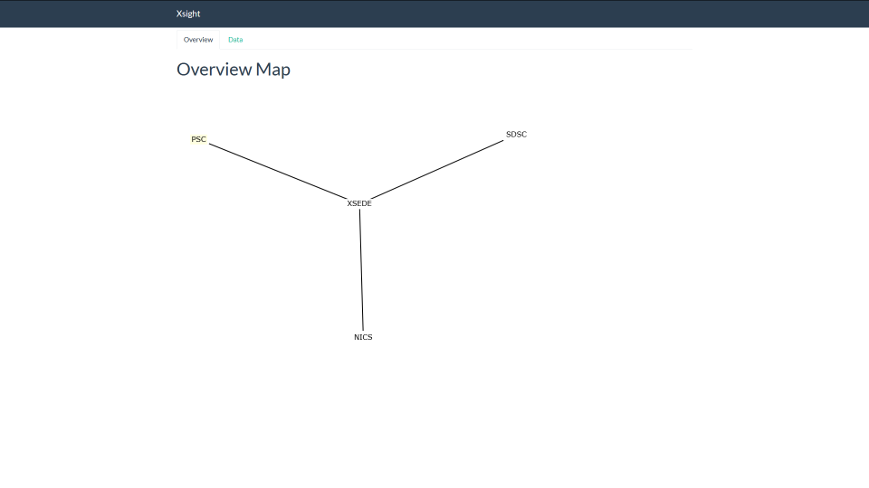

Slide 15
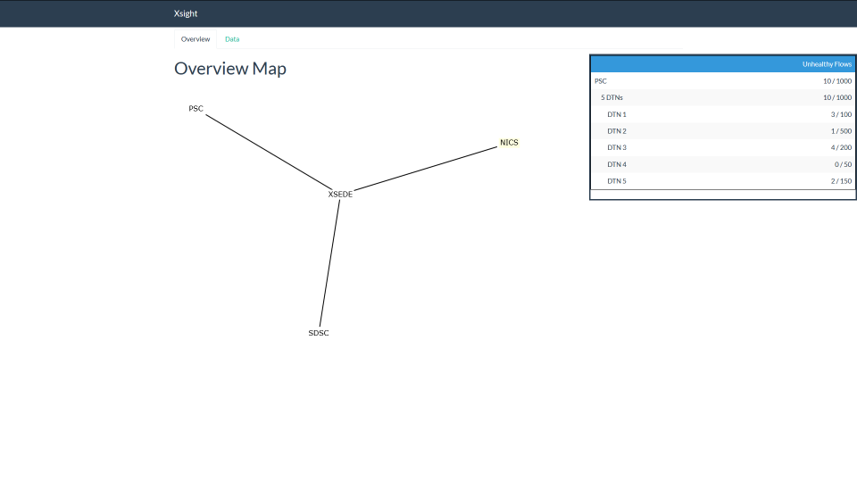

Slide 16
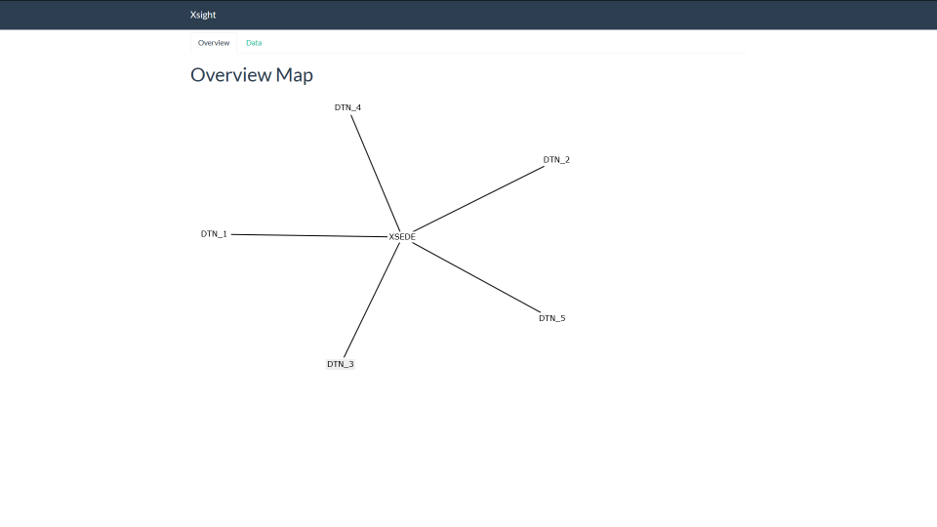

Slide 17
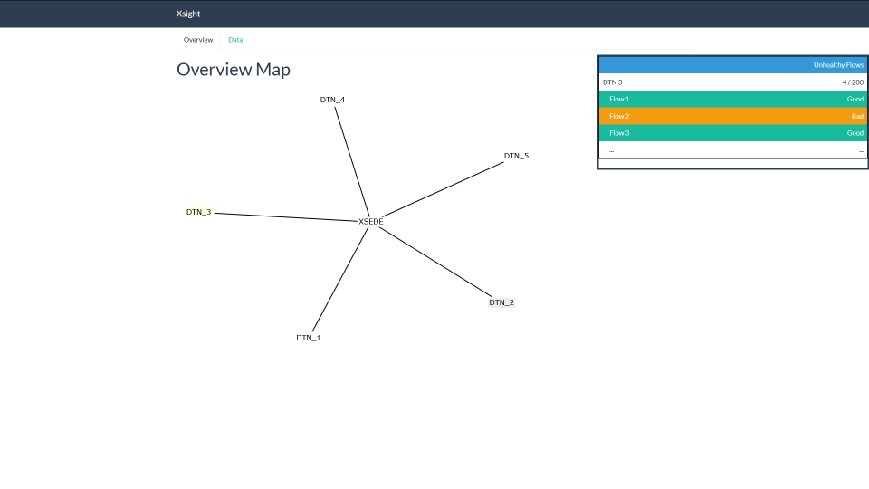

Slide 18
Brief Mention
TestRig2.0
Aimed at providing users with a dynamically generated bootable ISO to automate network testing.
Uses Web10g to collect information on the evolution of TCP test flows.
Also used and Web10g enabled version of NDT

Slide 19
Conclusion
End host TCP stack data is important
It’s also important that you do something with it.
We have to start building tools that are:
Real or near real time
Real world
Real useful

Slide 20
Thanks!
rapier@psc.edu
XSight: http://www.nsf.gov/awardsearch/showAward?AWD_ID=1521303
TestRig2.0: http://www.nsf.gov/awardsearch/showAward?AWD_ID=1534836

