Slide 1
UCI Lightpath A Dedicated Network for Research on UCI Campus
Jessica Yu
Office of Information Technology, UC Irvine
NSF PI Workshop
9/29/2015

Slide 2
About University of California, Irvine
UC Irvine is a public research university
30,000+ students and 22,000+ faculty and staff
Located in Irvine, California
UCINet is the general campus network
191 Buildings
529 Network equipment closets
1,709 Routers, switches in service
40,755 Active network jacks

Slide 3
Purposes
UCI Lightpath
is built to let researchers with need for transferring large quantities of data to get on a faster network, ahead of general campus network upgrade
Improves data throughput within and beyond campus by avoiding bottlenecks and other performance impacting components in general campus network

Slide 4
Current Status
In service 6 month after funding started in 1/2014, connecting
two major campus computing clusters as well as a number of servers/workstations in research labs; providing the capability for 100+ researchers to utilize UCI Lightpath
perfSONAR servers in strategic locations collecting stats
DTN for concept proving for Pacific Research Platform
Special DTN for early adoption of technology for LHC collaboration

Slide 5
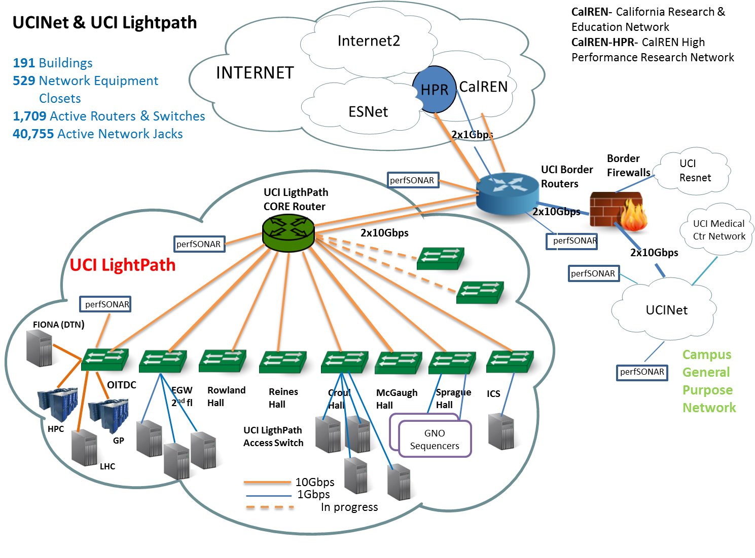

Slide 6
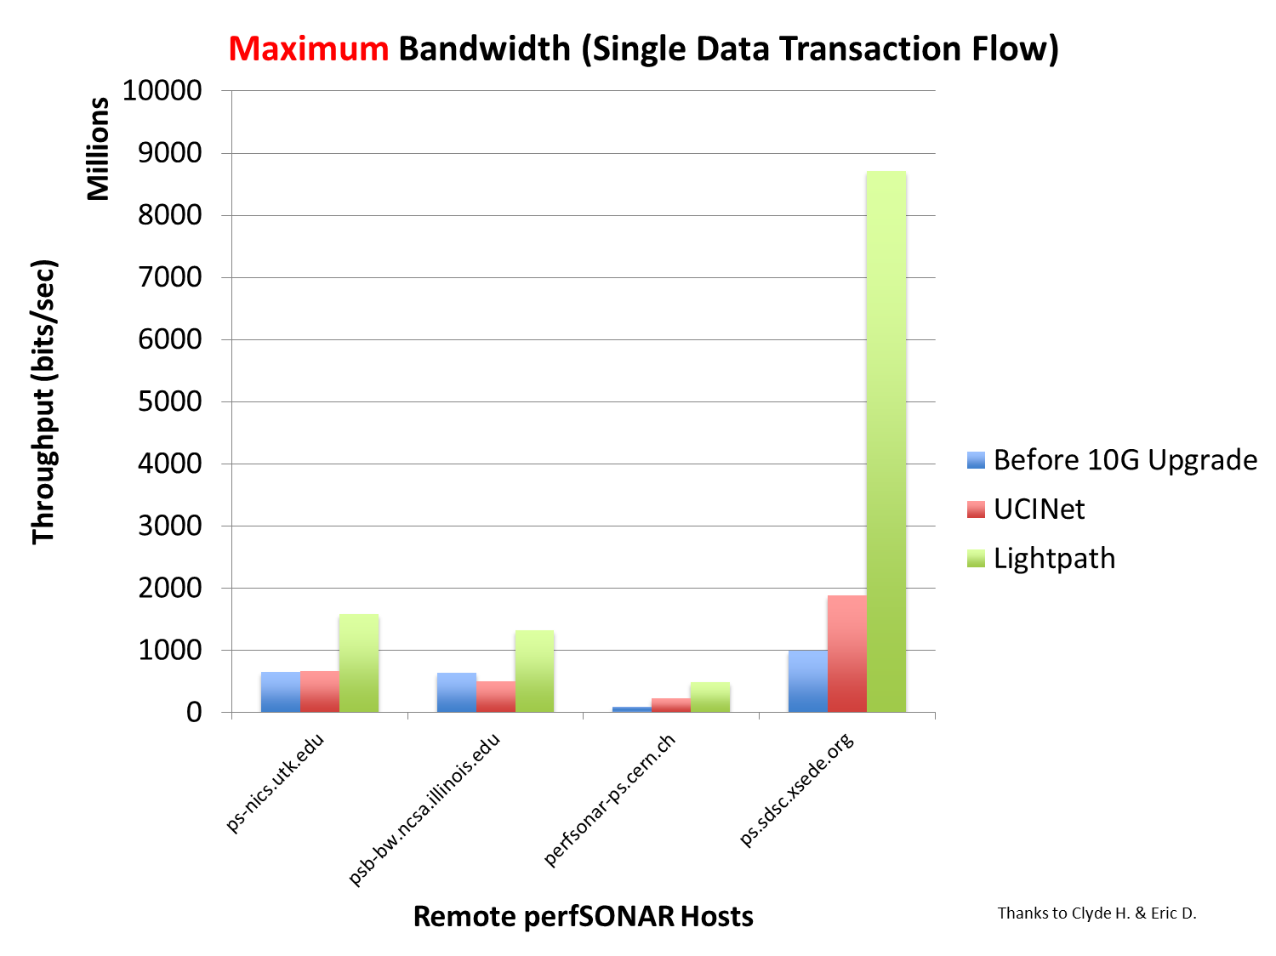

Slide 7
Impacts
Allows researchers on the ‘network slums’ of old buildings access to faster network, resulting in improved data transfer performance and increased productivity
Helps to avoid network bottlenecks and limitations of campus border firewall
Contributes to leading-edge research networking initiatives, such as proof-of-concept for PRP and LHC collaboration
Can be expanded to where needed
Advisory Committee and Access Policy

Slide 8
Acknowledgements
NSF for sponsoring this Project (CC-NIE #ACI-1341038)
Office of Information Technology of UC Irvine for providing technical resources to implement UCI Lightpath

Slide 9
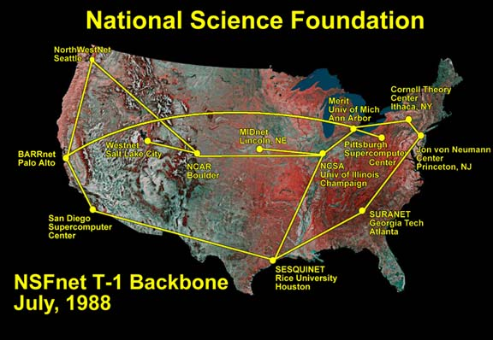
Food for Thoughts
25+ years ago, NSF funded the NSFNet which is widely recognized as the base platform evolving to today’s Internet
Change the way people live
What could CC* do for the next 25+ years?
CC-NIE, CC*DNI …

Slide 10
Food for Thoughts
25+ years ago, NSF funded the NSFNet which is widely recognized as the base platform evolving to today’s Internet
Change the way people live
What could CC* do for the next 25+ years?
CC-NIE, CC*DNI …

