Slide 1
Campus Design – Successes and Challenges
Michael Cato, Vassar College
Mike James, Northwest Indian College
Carrie Rampp, Franklin and Marshall
Thomas Steffes, Earlham College
Moderator: Rick McMullen, Internet2

Slide 2
Introductory remarks by Kevin Thompson,
National Science Foundation
Program Director for the Campus Cyberinfrastructure program

Slide 3
Introductions
Moderator: Rick McMullen, Internet2
Michael Cato, Vassar College
Mike James, Northwest Indian College
Carrie Rampp, Franklin and Marshall
Thomas Steffes, Earlham College

Slide 4
Panel Discussion Questions
General questions
  Impact of project on scientific research
  Particularly interesting or novel approaches in project implementation
  What you've learned that may transfer to others
  Successes you’ve had so far
  Challenges or what you would like to learn from others
Campus design questions
  How did you engage your faculty and staff to to plan your proposal?
  Were there any significant changes in your overall approach to campus networking as a result of this grant?
  How does your project fit within your overall cyberinfrastructure plan?
  What outside support or expertise, if any, do you think you will need to accomplish your project’s goals, and where will you seek that support?

Slide 5
Michael Cato - Vassar College
CC*IIE Campus Design: Building a Next-Generation Research Network for Vassar College

Slide 6
Mike James - Northwest Indian College
CC*IIE Campus Design - Internet2 Infrastructure

Slide 7
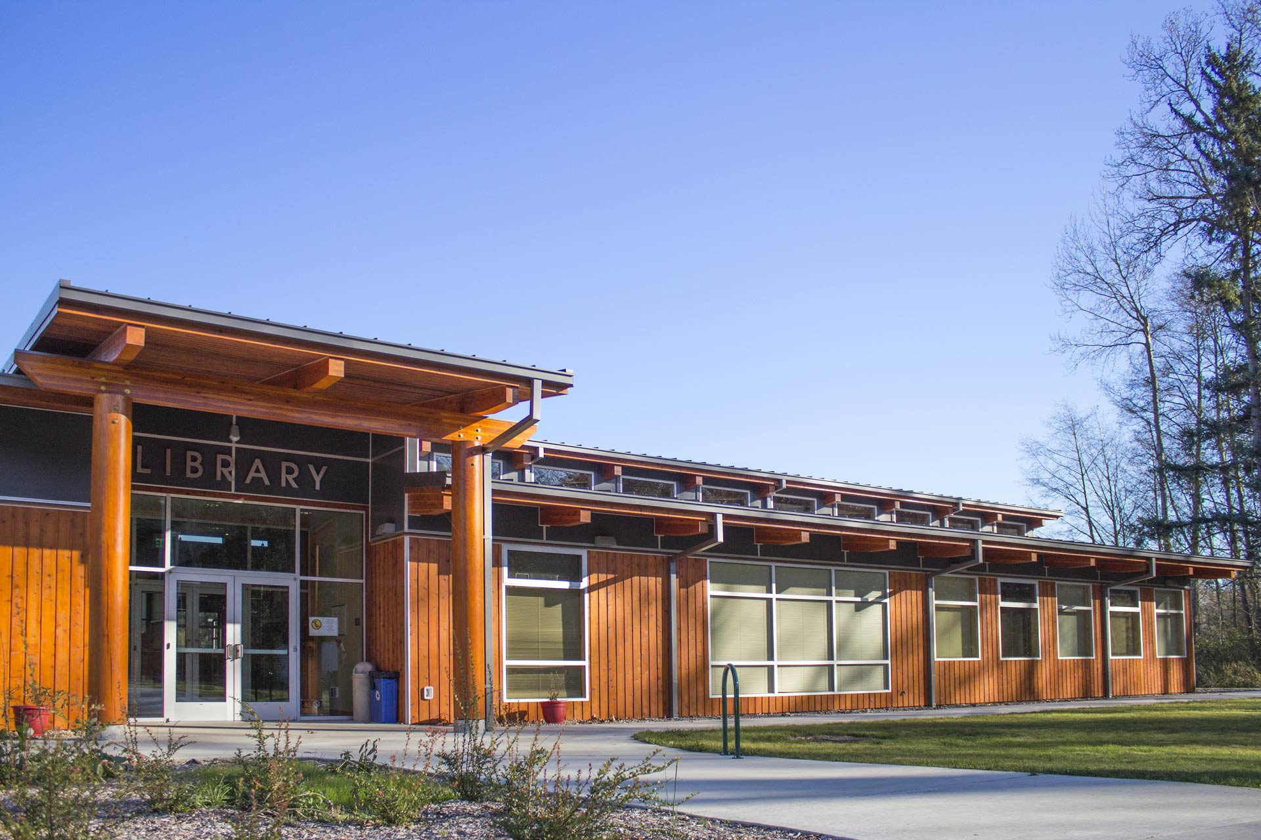


CC*IIE Cyberinfrastructure
NWIC IT Department:
Catalyzing Research at a Tribal College
Michael R. James I.T Director
Northwest Indian College
Mjames@nwic.edu www.nwic.edu

Slide 8
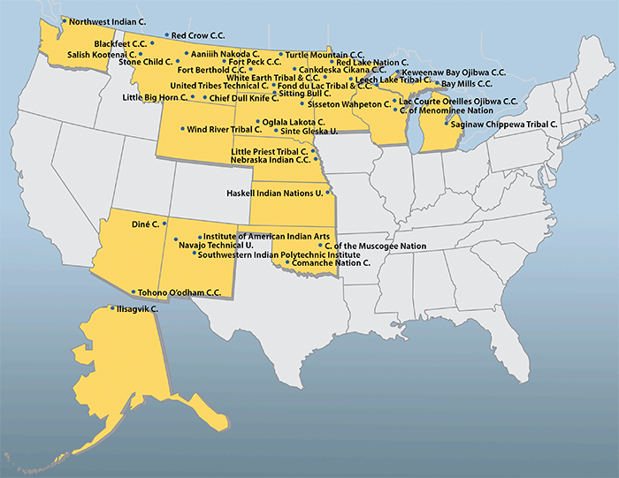
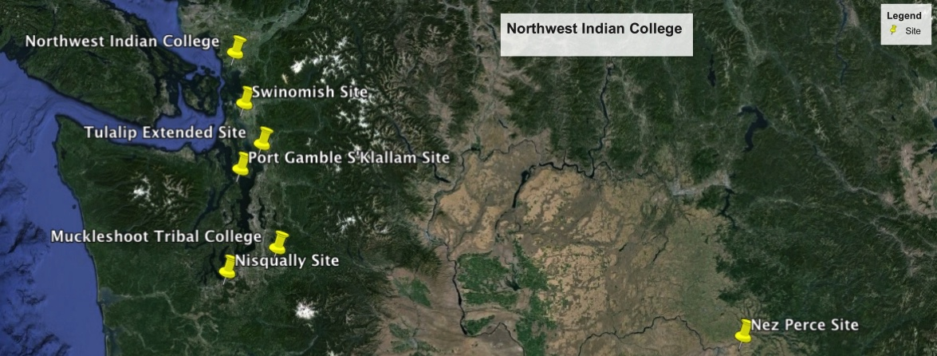
NWIC Extended Sites
Swinomish, Tulalip, Port Gamble, Muckleshoot, Nisqually and
Nez Perce

Slide 9
Core Components Successes
K-20 infrastructure Internet2
  Completed redundant networking
  Proof of concept Cluster and Cluster Storage are ready to go
  Science DMZ and SAN are built
  IPV4 transition to IPV6 capable
Off site Canvas currently being deployed September 21st 2015

Slide 10
Challenges
K-20 Infrastructure to Extended Sites for Reservations taking longer than expected
Application Servers needing upgraded from what was projected from current funding
Need training on Federation Servers and services
Collaboration with colleges and sustainability of personnel that hold key roles

Slide 11
Transformative Changes
Increased 100 meg at Extended Sites
Added servers and networking capabilities for collaboration with Extended Sites, Partners and Universities with DSA
Increased capability to allow us to serve and collaborate to more students
Increased number of funded research based Projects
Integrated research into NWIC Community

Slide 12

Hy’shqe

Slide 13
Carrie Rampp - Franklin and Marshall College
CC*DNI Campus Design: Building a State-Of-The-Art Research Network at Franklin and Marshall College

Slide 14
Building a state-of-the-art Research Network at Franklin & Marshall College (awarded summer 2015)
Project Goals
  Expand/strengthen capacity for faculty collaboration with internal/external partners
  Expand capacity for multi-site collaborations involving research computing
  Better prepare F&M students for postgrad work/study in data-intensive fields
  Peer education/sharing: security considerations a Science DMZ will bring to a small college
.in general, get off the island…
Notes:
Carrie Rampp

Slide 15
Building a state-of-the-art Research Network at Franklin & Marshall College (awarded summer 2015)
What have we done so far? (nearly nothing!)
  Organizing for the project…
Anticipated Work:
Deploy perfSONAR
Design/deploy a research DMZ and necessary 10Gb/s upgrades
Design/deploy a data transfer node
Upgrade to 10Gb/s for campus, pilot Internet2 services, pilot ‘next gen’ HPC services such as PSC/3ROX
.in general, get off the island…

Slide 16
Thomas Steffes - Earlham College
CC*IIE Campus Design: Network Infrastructure for Improved Science Discovery and Education

Slide 17
Earlham is a national liberal arts college with a reputation for excellent teaching.
Earlham has a long tradition of undergraduate participation in research.
According to the 2012 NSSE report, 52 percent of seniors worked on a research project with a faculty member outside of course or program requirements.
A 2012 HEDS report ranked Earlham 29th amongst 1,547 institutions in graduating students who go on to receive doctoral degrees.
In the same survey, Earlham ranked 9th in the biological sciences.

Slide 18
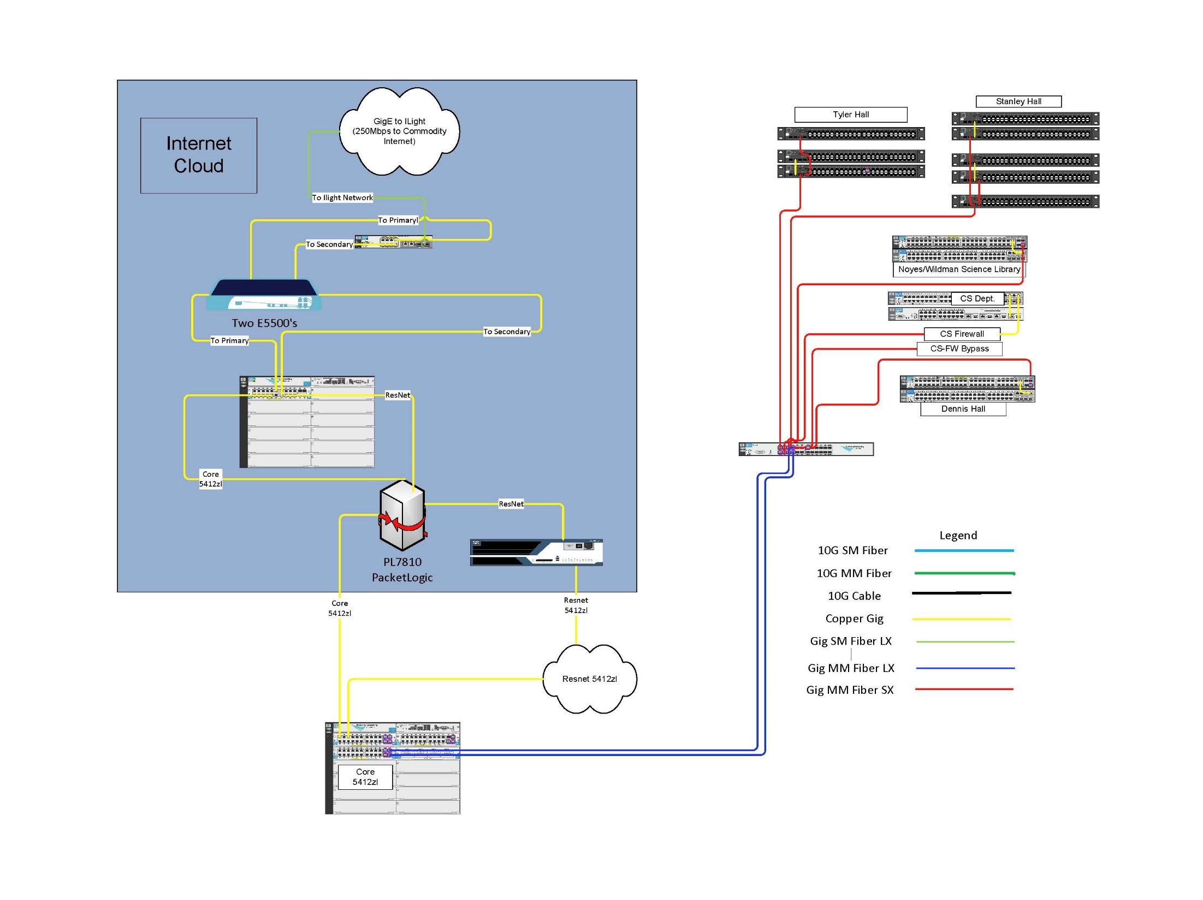
Notes:
As depicted in the diagram above, the traffic from all of these systems travel over the same 1Gbps connection into the core network switch to be distributed appropriately. Traffic continuing outside of campus travels through the Procera Packetshaper and the SonicWall firewall before transversing the I-Light 1Gbps connection to the Indiana Gigapop in Indianapolis, where it is routed either to the commodity network or to Internet2.

Slide 19
Fall of 2013 / Spring of 2014
A CS professor and a Biology professor were attempting to transfer data from their NSF funded research to Argonne National Laboratory for analysis using their MG-RAST facility. The transfer of 40 files, totaling around 80 Gb of data, was taking about 90 hours to complete. MG-Rast’s policy is to remove files after 72 hours if they were not part of an active workflow.

Slide 21
The project was comprised of the following tasks:
Upgrade the I-Light connection to 10Gbps
Upgrade the core network equipment to 10Gbps
Pull single mode (SM) fiber from the science complex to the ITS primary data center and from the fiber demarcation point in the science complex to the CS data center and two secondary wiring closets.
Upgrade the Science Complex aggregate switch, edge switches, and Computer Science data center switches to support 10Gbps
Create a virtual 10Gbps research network through the campus network to I-Light bypassing the firewall filters and rate limiting devices

