Slide 1
Leveraging Campus Resources and Engaging Researchers
NSF CC* PI 2015 Workshop
September 29, 2015

Slide 2
Introductions
Moderator: Scott Valcourt, University of New Hampshire
Thomas Cheatham, University of Utah
Kelli Trosvig, University of Washington
Michael Turner, University of Alabama in Huntsville

Slide 3
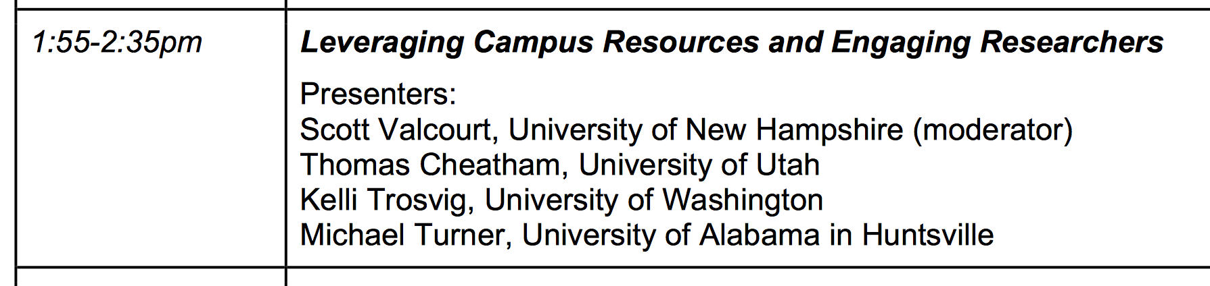
University Information Technology
“Hi, we’re from central administration, we’re here to help…”
tec3@utah.edu
Engaging researchers? ✔
Leveraging campus resources? X
(exception: many researchers do not know we exist!)
(exception: Joe Breen and networking)

Slide 4
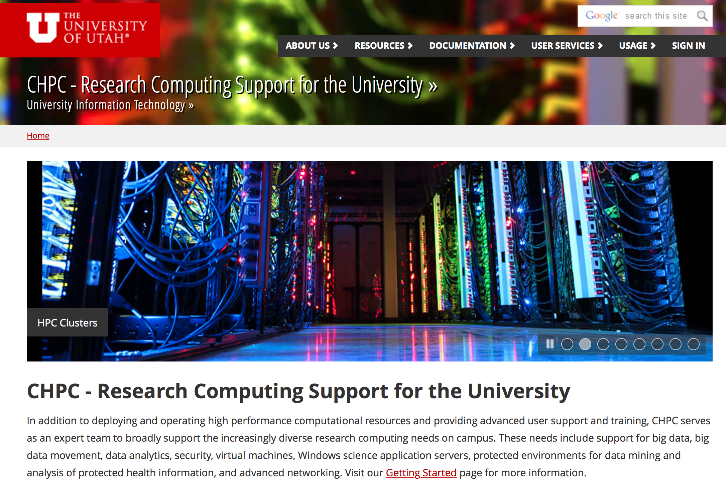
Center for High Performance Computing, UIT
http://www.chpc.utah.edu

Slide 5
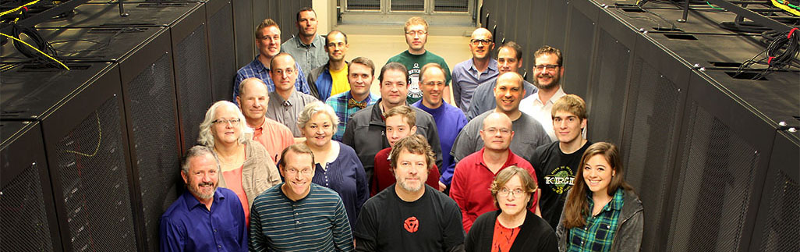
Center for High Performance Computing, UIT
http://www.chpc.utah.edu
Research Computing at the University of Utah
Free accounts, compute cycles, varied software
> 15,000 cores
> 8.5 PB disk (and growing!)
science DMZ, 40 Gb/sec backbone, 100 Gb/sec I2
“protected” environment (HIPAA, export control, …)
“bare” metal hardware, CloudLab / Apt, VMs
Globus DTNs (data transfer nodes), guest-transfer, …

Slide 6
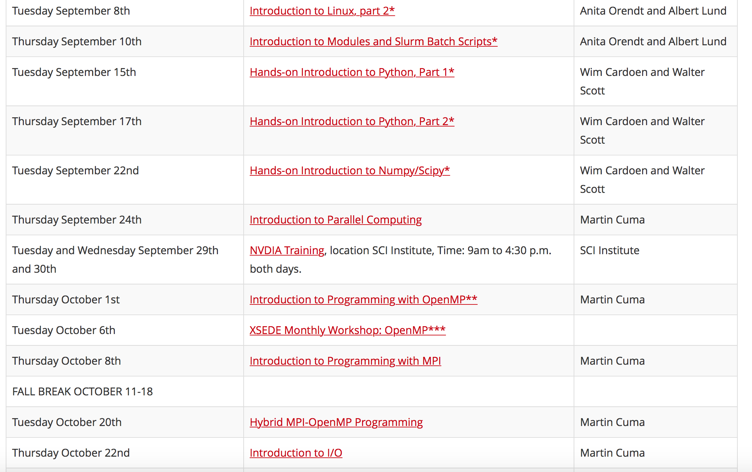
https://www.chpc.utah.edu/presentations/Fall2015CHPCPresentationSchedule.php

Slide 7

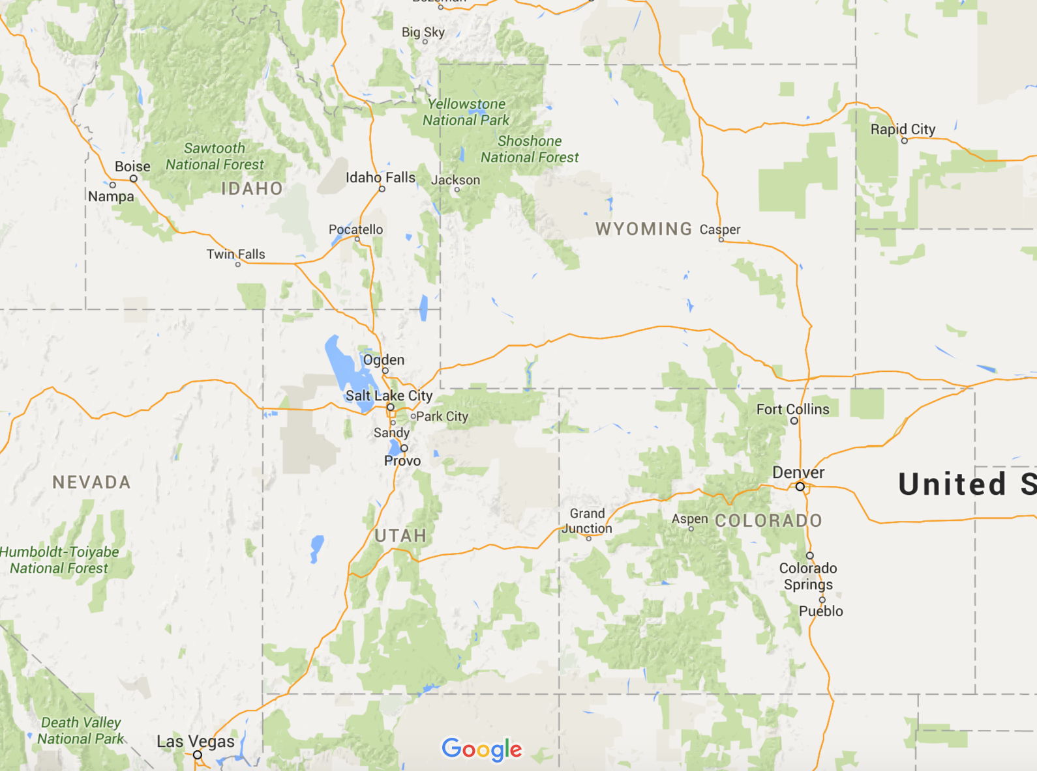







Slide 8
disrupting campus
resources / infrastructure
Google
Amazon
?

Slide 9

How to influence central (and distributed) IT on campus?
…in the region?
…nationally???
protected environment (FISMA)
object storage (research data)
How to (securely) share data / knowledge / cycles with collaborators?
SDN / science DMZ, DTNs, …
regional collaboration (RMACC cycles, sys admin retreat)
national collaboration (OSG, XSEDE)

Slide 10
University of Washington
No. 1 in Federal research dollars among all public universities
No. 4 Most Innovative World Universities
Reuters Top 100, 2015
No. 7 in the nation for social mobility, research and service
Washington Monthly, 2015
No. 11 among world universities
Middle East Technical University, 2014-15
No. 14 among global universities
U.S. News & World Report, 2014
No. 15 in the Academic Ranking of World Universities
Shanghai Jiao Tong University, 2015
No. 16 among public U.S. universities
U.S. News & World Report, 2016
  5 National Medal of Science winners
  6 Nobel Prize winners
  15 MacArthur fellows
  87 members of the American Academy of Arts & Sciences
  61 members of the Institute of Medicine of the National Academies
  168 fellows in the American Association for the Advancement of Science
  30 members of the National Academy of Engineering
  79 members of the National Academy of Sciences
  31 Presidential early career awards in Science and Engineering

Slide 11
University of Washington’s Current Successes
Computer Science and Engineering
Internet scanning traffic that generates extremely high packet rates
Genome Sciences
Large data transfer requirements
Institute for Protein Design
Large data transfer requirements, distributed analysis application

Slide 12
University of Washington In Progress
Physics Department
Large data transfer requirements. Working to tune data acquisition devices to permit higher throughput.
Atmospheric, Earth, and Space Sciences
Large data transfer requirements. Building undergoing significant physical plant upgrades to support high speed connectivity.
Ongoing Outreach to Research Departments
Data Science Studio Direct Outreach

Slide 13
University of Washington Network Automation
Successfully completed Phase 1 of the project to completely automate the configuration of campus network switches. This phase fully automated the firmware update and configuration of equipment in place and provided a simple interface to perform many standard tasks.
Phase 2 will allow non-technical staff to make requested business as usual changes. The goal is to transfer business as usual configuration work to support staff that directly communicates with the customers to reduce time to deploy for new or changed services.

Slide 14
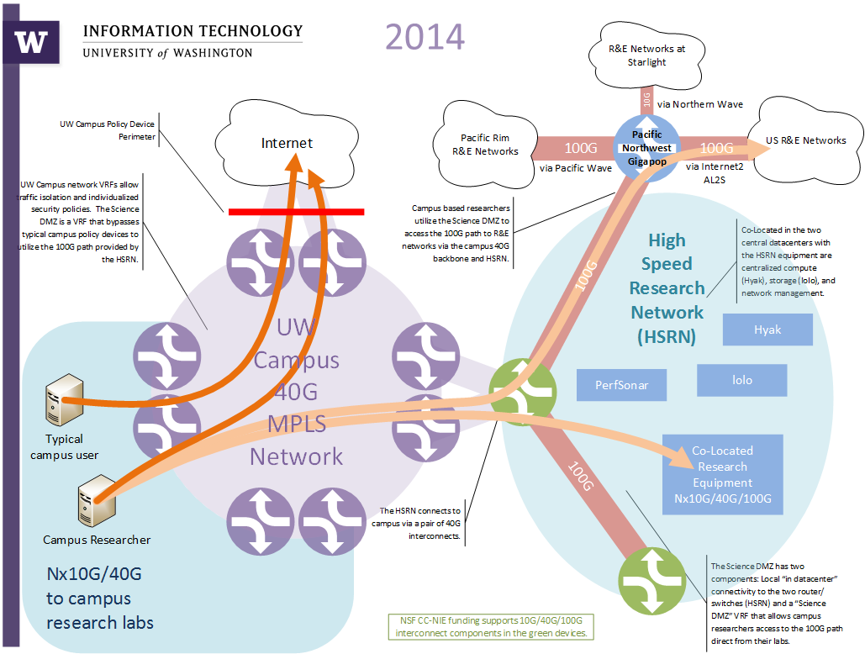

Slide 15

University of Alabama in Huntsville
Cyberinfrastructure Overview

Slide 16
Overview
UAH is the largest of several Universities in Huntsville, AL
  Fall enrollment was over 7,500
UAH has several large research projects as well as many smaller scale projects
  Severe Weather Institute and Radar Lightning Lab (SWIRLL) is a $7M Atmospheric Research Facility
  Center for Space Plasma and Aeronomic Research (CSPAR) is a the cornerstone of UAH’s space research
  Information Technology and Systems Center (ITSC) provides advanced HPC services for:
    Global Hydrology Resource Center (GHRC) – one of 12 NASA Earth Science Archives
    DSS Environment for Modeling Atmospheric Nutrient Deposition (DEMAND) – research modeling air quality impacts of regional and national significance

Slide 17
Cyberinfrastructure Initiation
UAH hired a cyberinfrastructure engineer in late December 2014
Spent most of January learning the network infrastructure across campus
Spent most of February and March meeting with various scientists and researchers on campus
Several problems hinder the full utilization of the cyberinfrastructure by the scientist/researchers:
  Lack of regular communications between organizations
  Aging network infrastructure supporting only 10/100Mbps
  Incompatible “Empire Building” across campus – various organizations doing their own thing

Slide 18
What have we done to fix it?
The UAH Cyberinfrastructure Engineer has met with all of the different organizations
  Gathered requirements from the scientists/researchers
    Sometimes this required additional time and discussion to fully develop what they were actually needing based on the science they were performing
  Worked with the Office of Information Technology (OIT) Network Infrastructure Team to recommend and support several key network changes
    Replaced aging firewall and border router
    Supported development of a Access Layer refresh plan
    Researched Software Defined Networking
    Increased implementation of local perfSONAR instances

Slide 19
Future Steps
Continue to work with the scientists/researchers across campus to see if we are improving their end-user experience
Begin to create a local community of interest across North Alabama, the state, and the region
Hosting the 2nd Southern Partnership for Advanced Networking conference on campus November 3rd and 4th
  Partnering with Clemson and SOX to host the conference at the UAH Charger Union Theater
  Registration is open to everyone, with a focus on universities in the southern region
  More information can be found at:
    http://citi.clemson.edu/workshop/cciie/index.html

Slide 20
Panel Discussion Questions
What are some ways that have been successful in getting the campus research community to connect?
What are key barriers to researchers that CI can address?
Who are the key decision makers that need to support the CI vision and how do you engage them?

