Slide 1
Connecting Community Anchors and R&E Support for Community Networks
Feb 6, 2020 | 3:30PM-5:30PM

Slide 2
Agenda
Charlotte Bewersdorff, Merit Network
Bridging rural broadband divide – Michigan Moonshot update & discussion on state initiatives to coordinate broadband planning and investment
Essam El-Beik, Illinois Century Network
K-12 initiatives – briefing on K-12 initiatives as well as transition from E-rate provider to consortium filer
Stephanie Stenberg, Internet2
Community Anchor Program Update

Slide 3
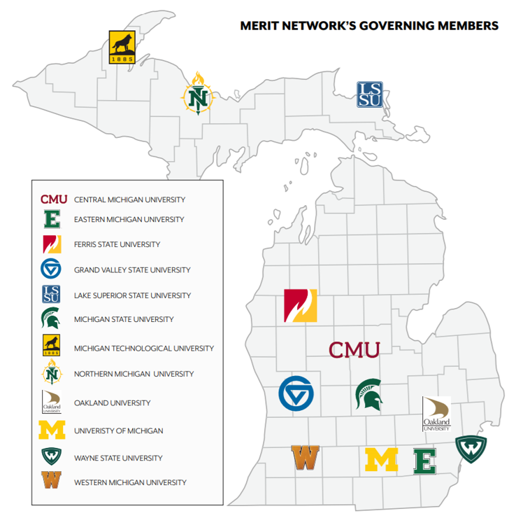
Merit, the longest running R&E network in the U.S., is an independent non-profit organization governed by 12 public universities and supported by over 370 affiliate members and anchor institutions.
Our Members are community-facing organizations from across the education, library, government, healthcare and non-profit sectors.

Slide 4
OURMISSION
Connecting organizations and building community
Network Security Community

Slide 5
MERIT’S
BACKBONE
NETWORK

Slide 7
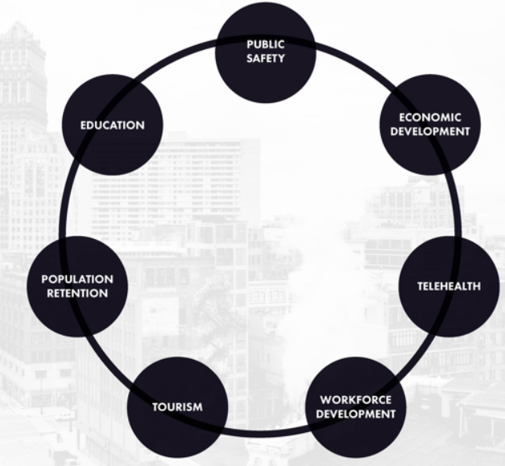

Slide 11
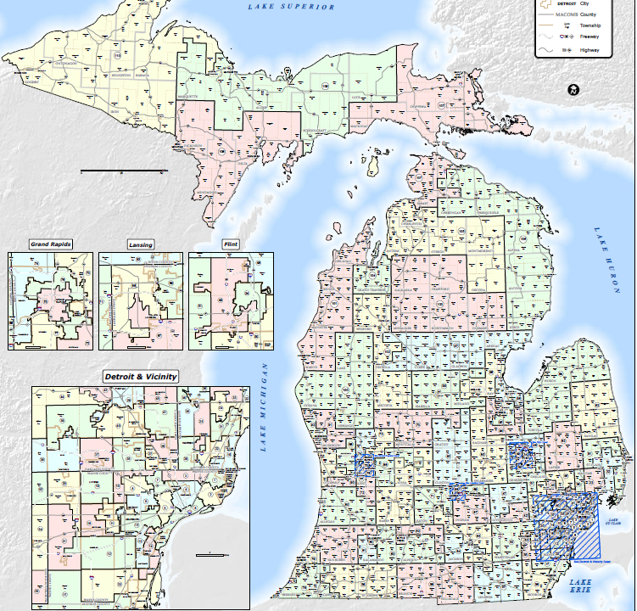
EUP ISD
2,750 Students
79 Classrooms
DeTour Area Schools, Pickford Public Schools, St. Ignace Area Schools, Les Cheneaux Community Schools, Moran Township School District, Mackinac Island Public Schools, Bois Blanc Pines School District, Rudyard Area Schools, Sault Ste. Marie Area Schools, Brimley Area Schools, Engadine Consolidated Schools, Tahquamenon Area Schools, Whitefish Township Schools, Joseph K. Lumsden Bahweting Anishnabe PSA, Ojibwe Charter School
JASON KRONEMEYER
SCCRESA
3,517 Students
104 Classrooms
10 Schools
Capac Jr/Sr High, Marine City Middle, Marine City High l, St. Clair Middle, St. Clair High, Mempish Jr/Sr, Yale Jr./Sr. High
DENNIS BUCKMASTER
MOISD
650 Students
19 Classrooms
2 Schools
Morley Stanwood Jr./ High
FRED SHARPSTEEN
PHIL STEIR

Slide 12
Approach
Paper Survey
PSAT 8/9, PSAT 10, and SAT
Speed Test
Video/lesson
Paper survey
Speed test
Student Key

Slide 15
Leveraging Moonshot for Community Networks Engagement
Framework Executive Summary
Online flip-book
Monthly Moonshot Newsletter
Local engagement
- Persona’s resource finder
- Readiness Questionnaire
https://www.merit.edu/services/moonshot/

Slide 16
Other Community Resources
ILSR
https://ilsr.org/
The SHLB Coalition
https://www.shlb.org/
Broadband Communities
https://www.bbcmag.com/
Benton Institute – Broadband for America’s Future
https://www.benton.org
“State and local governments should facilitate comprehensive broadband strategies,
including encouraging the creation and growth of state research and education networks
and bringing institutions together to learn from one another.”
NDIA
https://www.digitalinclusion.org/
Next Century Cities
https://nextcenturycities.org/

